Slide 1


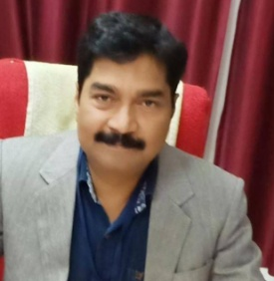
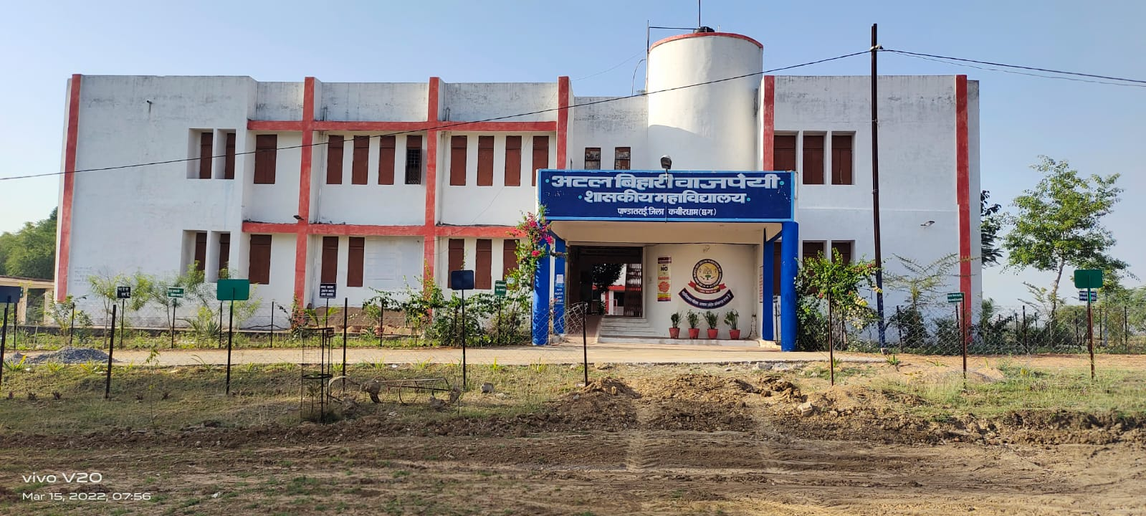
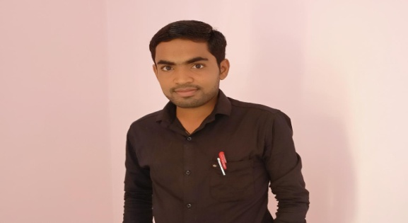
Atal Bihari Vajpayee Govt. College Pandatarai, Dist.-Kabirdham (C.G.)
Wb-https://abvgcp.ac.in
E-mail – pandataraigovtcollege3@gmail.com
Affiliated to Hemchand Yadav University Durg (C.G.)
SCIENCE FACULTY
SUBJECT- 1. ZOOLOGY
2. BOTANY
Dr. Avinash Kumar Lall
( Principal)
Atal Bihari Vajpayee Govt. College pandatarai Dist.-Kabirdham (C.G.)
Lav Kumar Verma
Lecturer Zoology
A.B.V. G.C.P. Dist.-Kabirdham (C.G.)

Slide 2


Atal Bihari Vajpayee Govt. College Pandatarai, Dist.-Kabirdham (C.G.)
Wb-https://abvgcp.ac.in
E-mail – pandataraigovtcollege3@gmail.com
NAME OF PROGRAMME
B.Sc. (Biology Group)
Presented By Lav Kumar Verma Lecturer Zoology

Slide 3
Atal Bihari Vajpayee Govt. College Pandatarai, Dist.-Kabirdham (C.G.)
Wb-https://abvgcp.ac.in
E-mail – pandataraigovtcollege3@gmail.com
ABOUT THE PROGRAMME
The B.Sc. (Biology) UG programme was started in 2011.
In this programme subjects (F.C., Botany, Zoology & Chemistry) are available for students.
The examination pattern is annually.

Slide 4
Atal Bihari Vajpayee Govt. College Pandatarai, Dist.-Kabirdham (C.G.)
Wb-https://abvgcp.ac.in
E-mail – pandataraigovtcollege3@gmail.com
OBJECTIVE OF THE PROGRAMME
To impart theoretical and empirical understanding of the subjects to its students.
To promote research activities of the faculty for better understanding of issues of science significance in country.
To help students pursue their higher education in Botany, Zoology and chemistry.

Slide 5
Atal Bihari Vajpayee Govt. College Pandatarai, Dist.-Kabirdham (C.G.)
Wb-https://abvgcp.ac.in
E-mail – pandataraigovtcollege3@gmail.com
PROGRAMME DETAIL
Programme | Course | Intake | Current Year
B.Sc. (Biology) | F.C. Hindi language, English Language, Chemistry, Zoology, Botany | 120 | 2021-22

Slide 6
Atal Bihari Vajpayee Govt. College Pandatarai, Dist.-Kabirdham (C.G.)
Wb-https://abvgcp.ac.in
E-mail – pandataraigovtcollege3@gmail.com
Faculty Profile
S.No | Name of Lecturer | Qualification | Specialization | Experience
1 | LAV KUMAR VERMA | M.Sc.B.Ed. PGDCA | ZOOLOGY | 4 years

Slide 7


POSITION OF SUPPORTING STAFF
Atal Bihari Vajpayee Govt. College Pandatarai, Dist.-Kabirdham (C.G.)
Wb-https://abvgcp.ac.in
E-mail – pandataraigovtcollege3@gmail.com
S. No. | Nature of Posts | Sanctioned Posts | Existing Numbers
1 | Technician | 03 | 01
2 | Lab Assistant | 03 | 02

Slide 8
Atal Bihari Vajpayee Govt. College Pandatarai, Dist.-Kabirdham (C.G.)
Wb-https://abvgcp.ac.in
E-mail – pandataraigovtcollege3@gmail.com
Students diversity
CLASS | 2015-16 |  |  |  | 2016-17 |  |  |  | 2017-18 |  |  |  | 2018-19 |  |  |  | 2019-20 |  |  |  | 2020-21 |  |  |  | 2021-22
 | GEN | SC | ST | OBC | GEN | SC | ST | OBC | GEN | SC | ST | OBC | GEN | SC | ST | OBC | GEN | SC | ST | OBC | GEN | SC | ST | OBC | GEN | SC | ST | OBC
B.Sc .1st | 4 | 33 | 19 | 82 | 5 | 22 | 15 | 78 | 3 | 29 | 3 | 85 | 10 | 21 | 2 | 83 | 9 | 24 | 2 | 81 | 14 | 25 | 6 | 74 | 6 | 19 | 3 | 91
B.Sc 2nd | 6 | 10 | 2 | 35 | 0 | 3 | 6 | 36 | 3 | 6 | 1 | 28 | 4 | 10 | 0 | 63 | 6 | 13 | 0 | 48 | 8 | 22 | 3 | 87 | 7 | 24 | 4 | 80
B.Sc. 3rd | 2 | 0 | 0 | 19 | 4 | 3 | 1 | 19 | 1 | 2 | 4 | 43 | 2 | 2 | 0 | 24 | 3 | 5 | 1 | 55 | 9 | 17 | 2 | 61 | 8 | 22 | 1 | 86

Slide 9
Atal Bihari Vajpayee Govt. College Pandatarai, Dist.-Kabirdham (C.G.)
Wb-https://abvgcp.ac.in
E-mail – pandataraigovtcollege3@gmail.com

Slide 10
Atal Bihari Vajpayee Govt. College Pandatarai, Dist.-Kabirdham (C.G.)
Wb-https://abvgcp.ac.in
E-mail – pandataraigovtcollege3@gmail.com
Year | 2015-16 |  |  | 2016-17 |  |  | 2017-18 |  |  | 2018-19 |  |  | 2019-20
Class | Admition Student | Exam Form Submit Student | Student pass | Admition Student | Exam Form Submit Student | Student pass | Admition Student | Exam Form Submit Student | Student pass | Admition Student | Exam Form Submit Student | Student pass | Admition Student | Exam Form Submit Student | Student pass
B.Sc. I | 138 | 120 | 23 | 121 | 102 | 25 | 120 | 112 | 51 | 120 | 114 | 69 | 116 | 112 | 111
B.Sc. II | 53 | 49 | 22 | 47 | 42 | 20 | 38 | 31 | 14 | 77 | 76 | 47 | 72 | 67 | 67
B.Sc. III | 21 | 16 | 14 | 27 | 27 | 23 | 51 | 32 | 29 | 29 | 26 | 24 | 63 | 60 | 60

Slide 11
Atal Bihari Vajpayee Govt. College Pandatarai, Dist.-Kabirdham (C.G.)
Wb-https://abvgcp.ac.in
E-mail – pandataraigovtcollege3@gmail.com

Slide 12
Atal Bihari Vajpayee Govt. College Pandatarai, Dist.-Kabirdham (C.G.)
Wb-https://abvgcp.ac.in
E-mail – pandataraigovtcollege3@gmail.com
Subject -Zoology

Slide 13


Atal Bihari Vajpayee Govt. College Pandatarai, Dist.-Kabirdham (C.G.)
Wb-https://abvgcp.ac.in
E-mail – pandataraigovtcollege3@gmail.com
PROGRAMM SPECIFIC OUTCOME
B.SC. -1
First paper
CO1 – Understand the DNA&RNA. Structure and Inportence.
Cel l transformation and immunity
CO1- to study the cell transformation & cancer and their agent.
CO2- understand about immunity and their role transplant rejection.
Second paper
HEMICHORDATA AND PROTOCHORDATA
CO1- To study the evolutionary importance of hemochordata & protochordata.
CO2- understand the character, histology and affinies of hemi & protochordata.
FISH, AMPHIBIA, & REPTILES HISTOLOGY AND PARANTAL CARE
CO1- understand the method of parental care in fishes and amphibian.
B.sc. 2
First Paper
Prigram specific outcome-
PSO1- Understand the blood coagulation system and their type’s through practical.
PSO2 -to study the hormones recepotor. Hormones gland and their disorder.
PSO3 -to study and understand the evolutionary biology.
PSO4- Understand the method of apiculture, pisiculture. Sericulture. Etc.
Second paper
CO1- to study the general character, action and disorder of hormones.
CO2- understand the role of hormones and their disorder.
B.Sc. 3
PROGRAM SPECIFIC OUTCOME
PS01- To study and understand the aims & scope of ecology.
PSO2- Solve the problems and also think methodology and draw a logical conclusion
PSO3- to study the general & applied microbiology and their role.
PSO4- understand about pathologenic micro organism their symptoms and treatment.

Slide 14
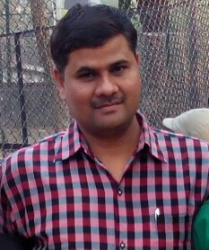
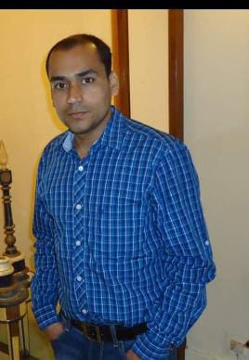
Atal Bihari Vajpayee Govt. College Pandatarai, Dist.-Kabirdham (C.G.)
Wb-https://abvgcp.ac.in
E-mail – pandataraigovtcollege3@gmail.com
Organizing a One Day Webinar on Date 06/04/2021
Subject - Career Guidance
Chairperson
Dr. Avinash Kumar Lall
Principal
Atal Bihari Vajpayee Govt. College pandatarai Dist.-Kabirdham (C.G.)
Speaker
Shri D.P. Kori
H.O.D. & Assts. Prof. Zoology Department
Govt. Naveen College Vishrampur, Dist.-Surajpur (C.G.)
Convenor
Dr. M.K. Tyagi
Assts. Prof. Chemistry
A.B.V. G.C.P. Dist.-Kabirdham (C.G.)
Co-Convenor
Shri Lav Kumar Verma
Lecturer Zoology
A.B.V. G.C.P. Dist.-Kabirdham (C.G.)
Join Zoom Meeting
https://us02web.zoom.us/j/87321335888?pwd=aHZlOWNCd2JKQmpQeVIxd0VYS2FJdz09
Meeting ID: 873 2133 5888
Passcode: 168733
Topic: Career Guidance
Time: Apr 6, 2021 11:30 AM India
Google Form Link :- https://forms.gle/MYyoiWEdNHTnnFCu5

Slide 15
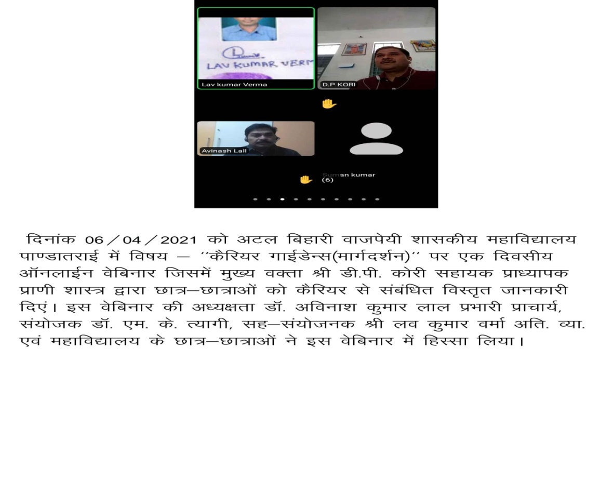
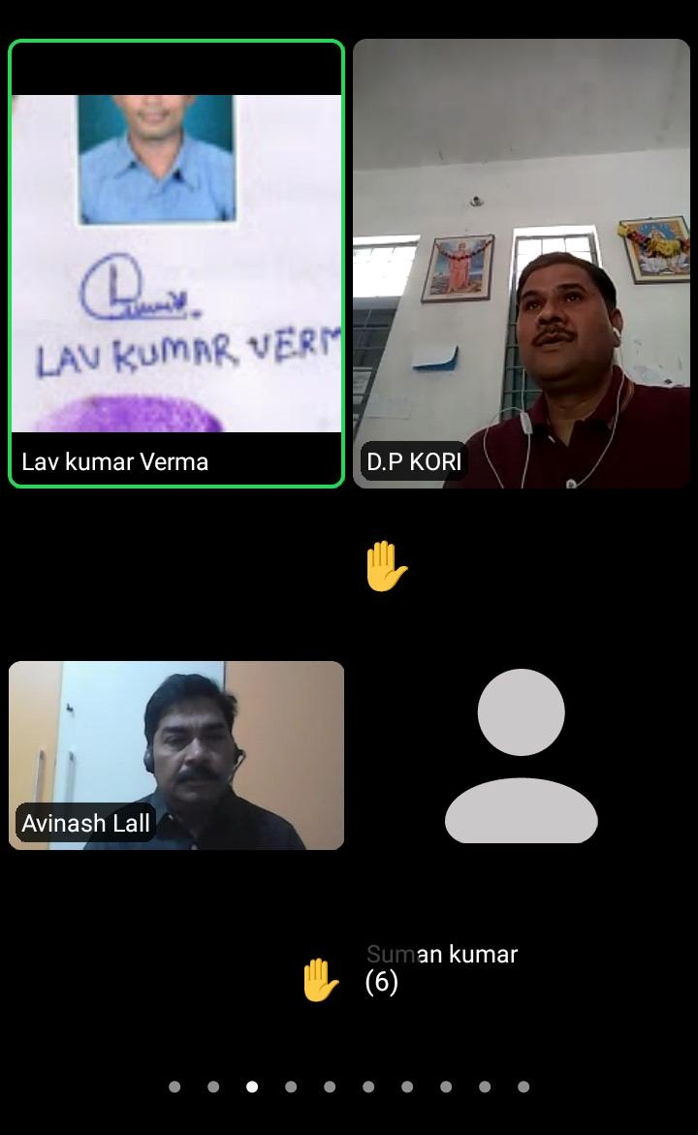
Atal Bihari Vajpayee Govt. College Pandatarai, Dist.-Kabirdham (C.G.)
Wb-https://abvgcp.ac.in
E-mail – pandataraigovtcollege3@gmail.com
Organizing a One Day Webinar on Date 06/04/2021
Subject - Career Guidance
https://abvgcp.ac.in/science/zoology/

Slide 16


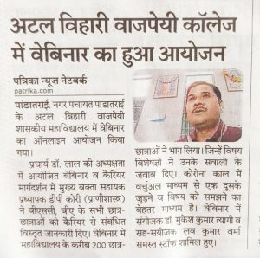
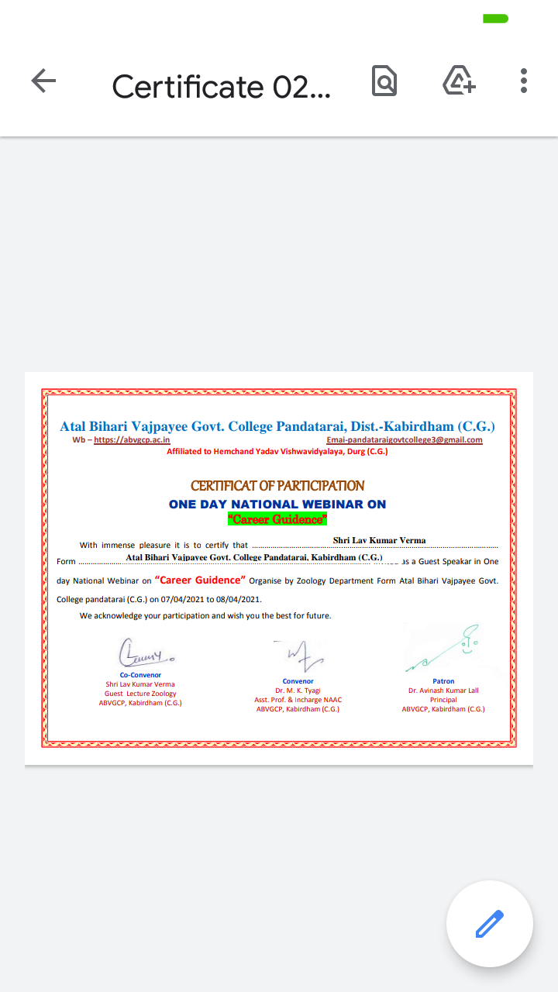
Atal Bihari Vajpayee Govt. College Pandatarai, Dist.-Kabirdham (C.G.)
Wb-https://abvgcp.ac.in
E-mail – pandataraigovtcollege3@gmail.com
दिनांक 06/04/2021 अटल बिहारी वाजपेयी शासकीय महाविद्यालय पांडातराई हमारे महाविद्यालय के प्राचार्य डॉ .अविनाश लाल सर के अध्यक्षता में आज वेबिनार का ऑनलाइन आयोजन किया गया जिसमें कैरियर मार्गदर्शन में मुख्य वक्ता सहायक प्रध्यापक डी. पी.कोरी (प्राणीशास्त्र) शासकीय नवीन महाविद्यालय विश्रामपुर ,जिला -सूरजपुर (छत्तीसगढ़ ) जिसमे बीएससी 1,2 3 बी. ए.1,2,3 सभी बच्चे को कैरियर से संबंधित जानकारी दिया गया। जिसमें 200 बच्चे ने भाग लिया। एवं संयोजक डॉ .मुकेश कुमार त्यागी और संयोजक लेक्चरर लव कुमार वर्मा (जन्तु विज्ञान) एंव समस्त स्टॉप सभी छात्र- छात्राये सम्मिलित हुये।
विषय- कैरियर मार्गदर्शन/

Slide 17
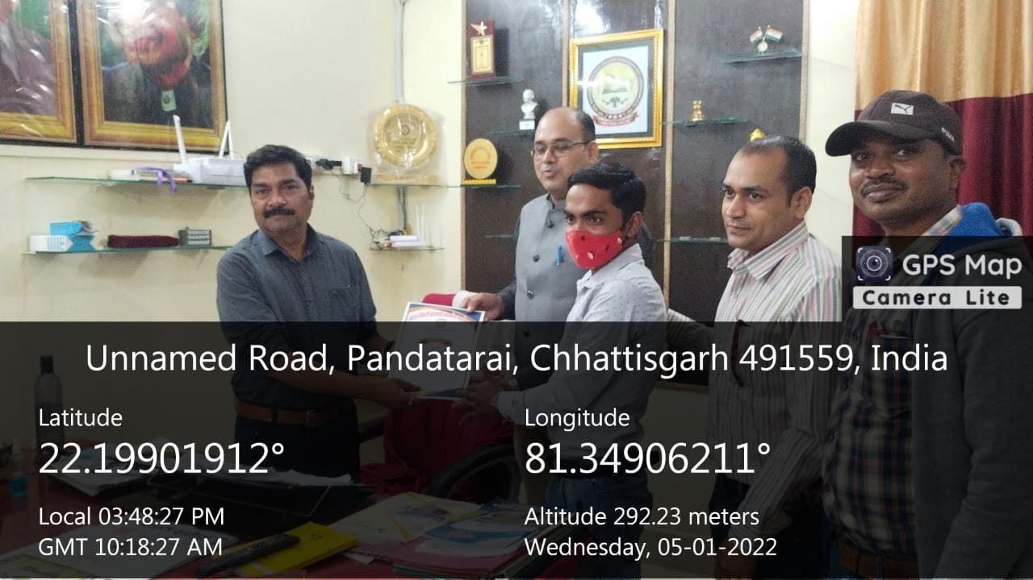
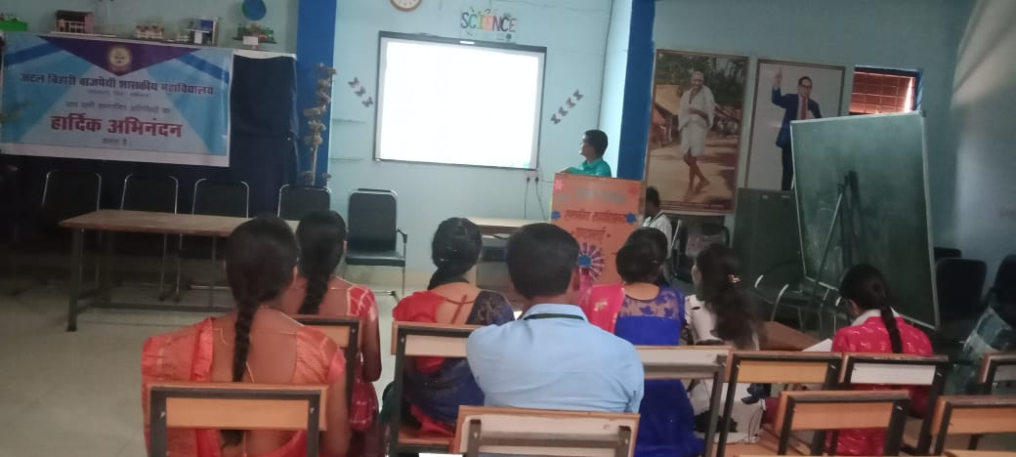
Atal Bihari Vajpayee Govt. College Pandatarai, Dist.-Kabirdham (C.G.)
Wb-https://abvgcp.ac.in
E-mail – pandataraigovtcollege3@gmail.com
LECTURE BY GUEST-TOPIC – BIOCHEMICAL TEST PROTEIN
प्राचार्य डॉ. अविनाश लाल

Slide 18


Atal Bihari Vajpayee Govt. College Pandatarai, Dist.-Kabirdham (C.G.)
Wb-https://abvgcp.ac.in
E-mail – pandataraigovtcollege3@gmail.com
Our Achievements
Name- SONU SAHU
Post- INDIAN RAILWAYS Hospital

Slide 19
Atal Bihari Vajpayee Govt. College Pandatarai, Dist.-Kabirdham (C.G.)
Wb-https://abvgcp.ac.in
E-mail – pandataraigovtcollege3@gmail.com
ZOOLOGY LAB
The Department of Zoology
The laboratory presents through its instruments an idea place for undergraduate students to study the histology of various cells, Tissue and Organs . Collection and preservation of animals species. Application of micro-techniques for slide preparation and staining of through fixation and sectioning. Slide identification of various histological slide tissue and organs sections. Identification of embryological slides and embryological stage. Exploration of the general Anatomy of animals from different phyla through various slides examination and observation of animals specimen preserved.
Major equipments used in the Laboratory
Centrifuge,
Binocular research microscope,
BP apparatus,
Hemoglobin meter,
Slide warmer,
Chromatography,
LCD projector.
Light microscope
ZOOLOGY LAB

Slide 20
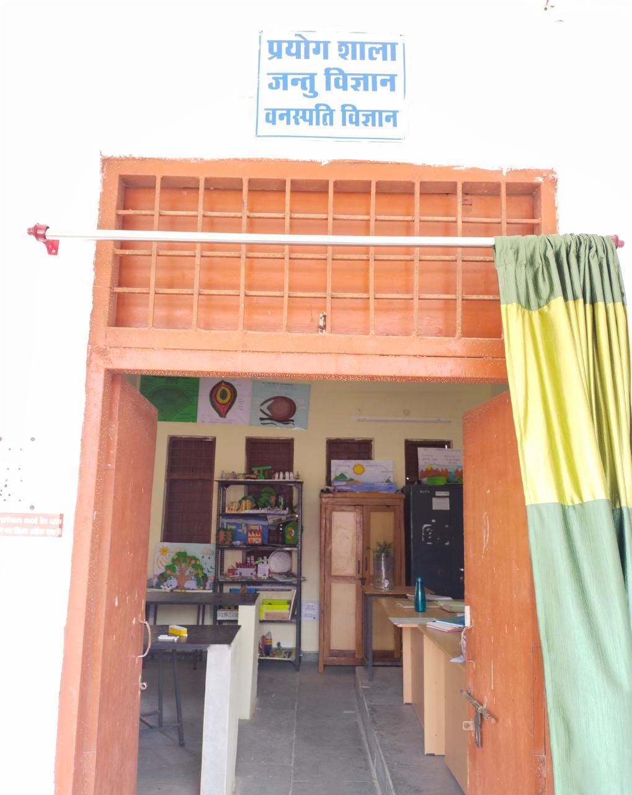
Atal Bihari Vajpayee Govt. College Pandatarai, Dist.-Kabirdham (C.G.)
Wb-https://abvgcp.ac.in
E-mail – pandataraigovtcollege3@gmail.com
ZOOLOGY LAB

Slide 21
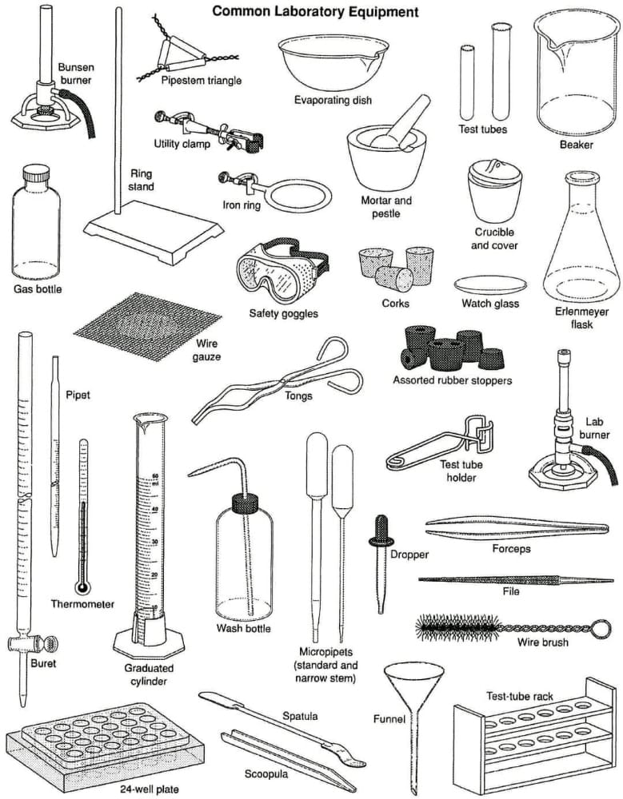
Atal Bihari Vajpayee Govt. College Pandatarai, Dist.-Kabirdham (C.G.)
Wb-https://abvgcp.ac.in
E-mail – pandataraigovtcollege3@gmail.com

Slide 22

Atal Bihari Vajpayee Govt. College Pandatarai, Dist.-Kabirdham (C.G.)
Wb-https://abvgcp.ac.in
E-mail – pandataraigovtcollege3@gmail.com

Slide 23
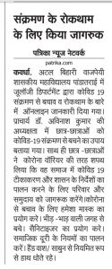

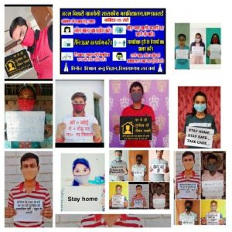
Atal Bihari Vajpayee Govt. College Pandatarai, Dist.-Kabirdham (C.G.)
Wb-https://abvgcp.ac.in
E-mail – pandataraigovtcollege3@gmail.com

Slide 24

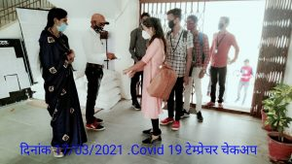
Atal Bihari Vajpayee Govt. College Pandatarai, Dist.-Kabirdham (C.G.)
Wb-https://abvgcp.ac.in
E-mail – pandataraigovtcollege3@gmail.com

Slide 25
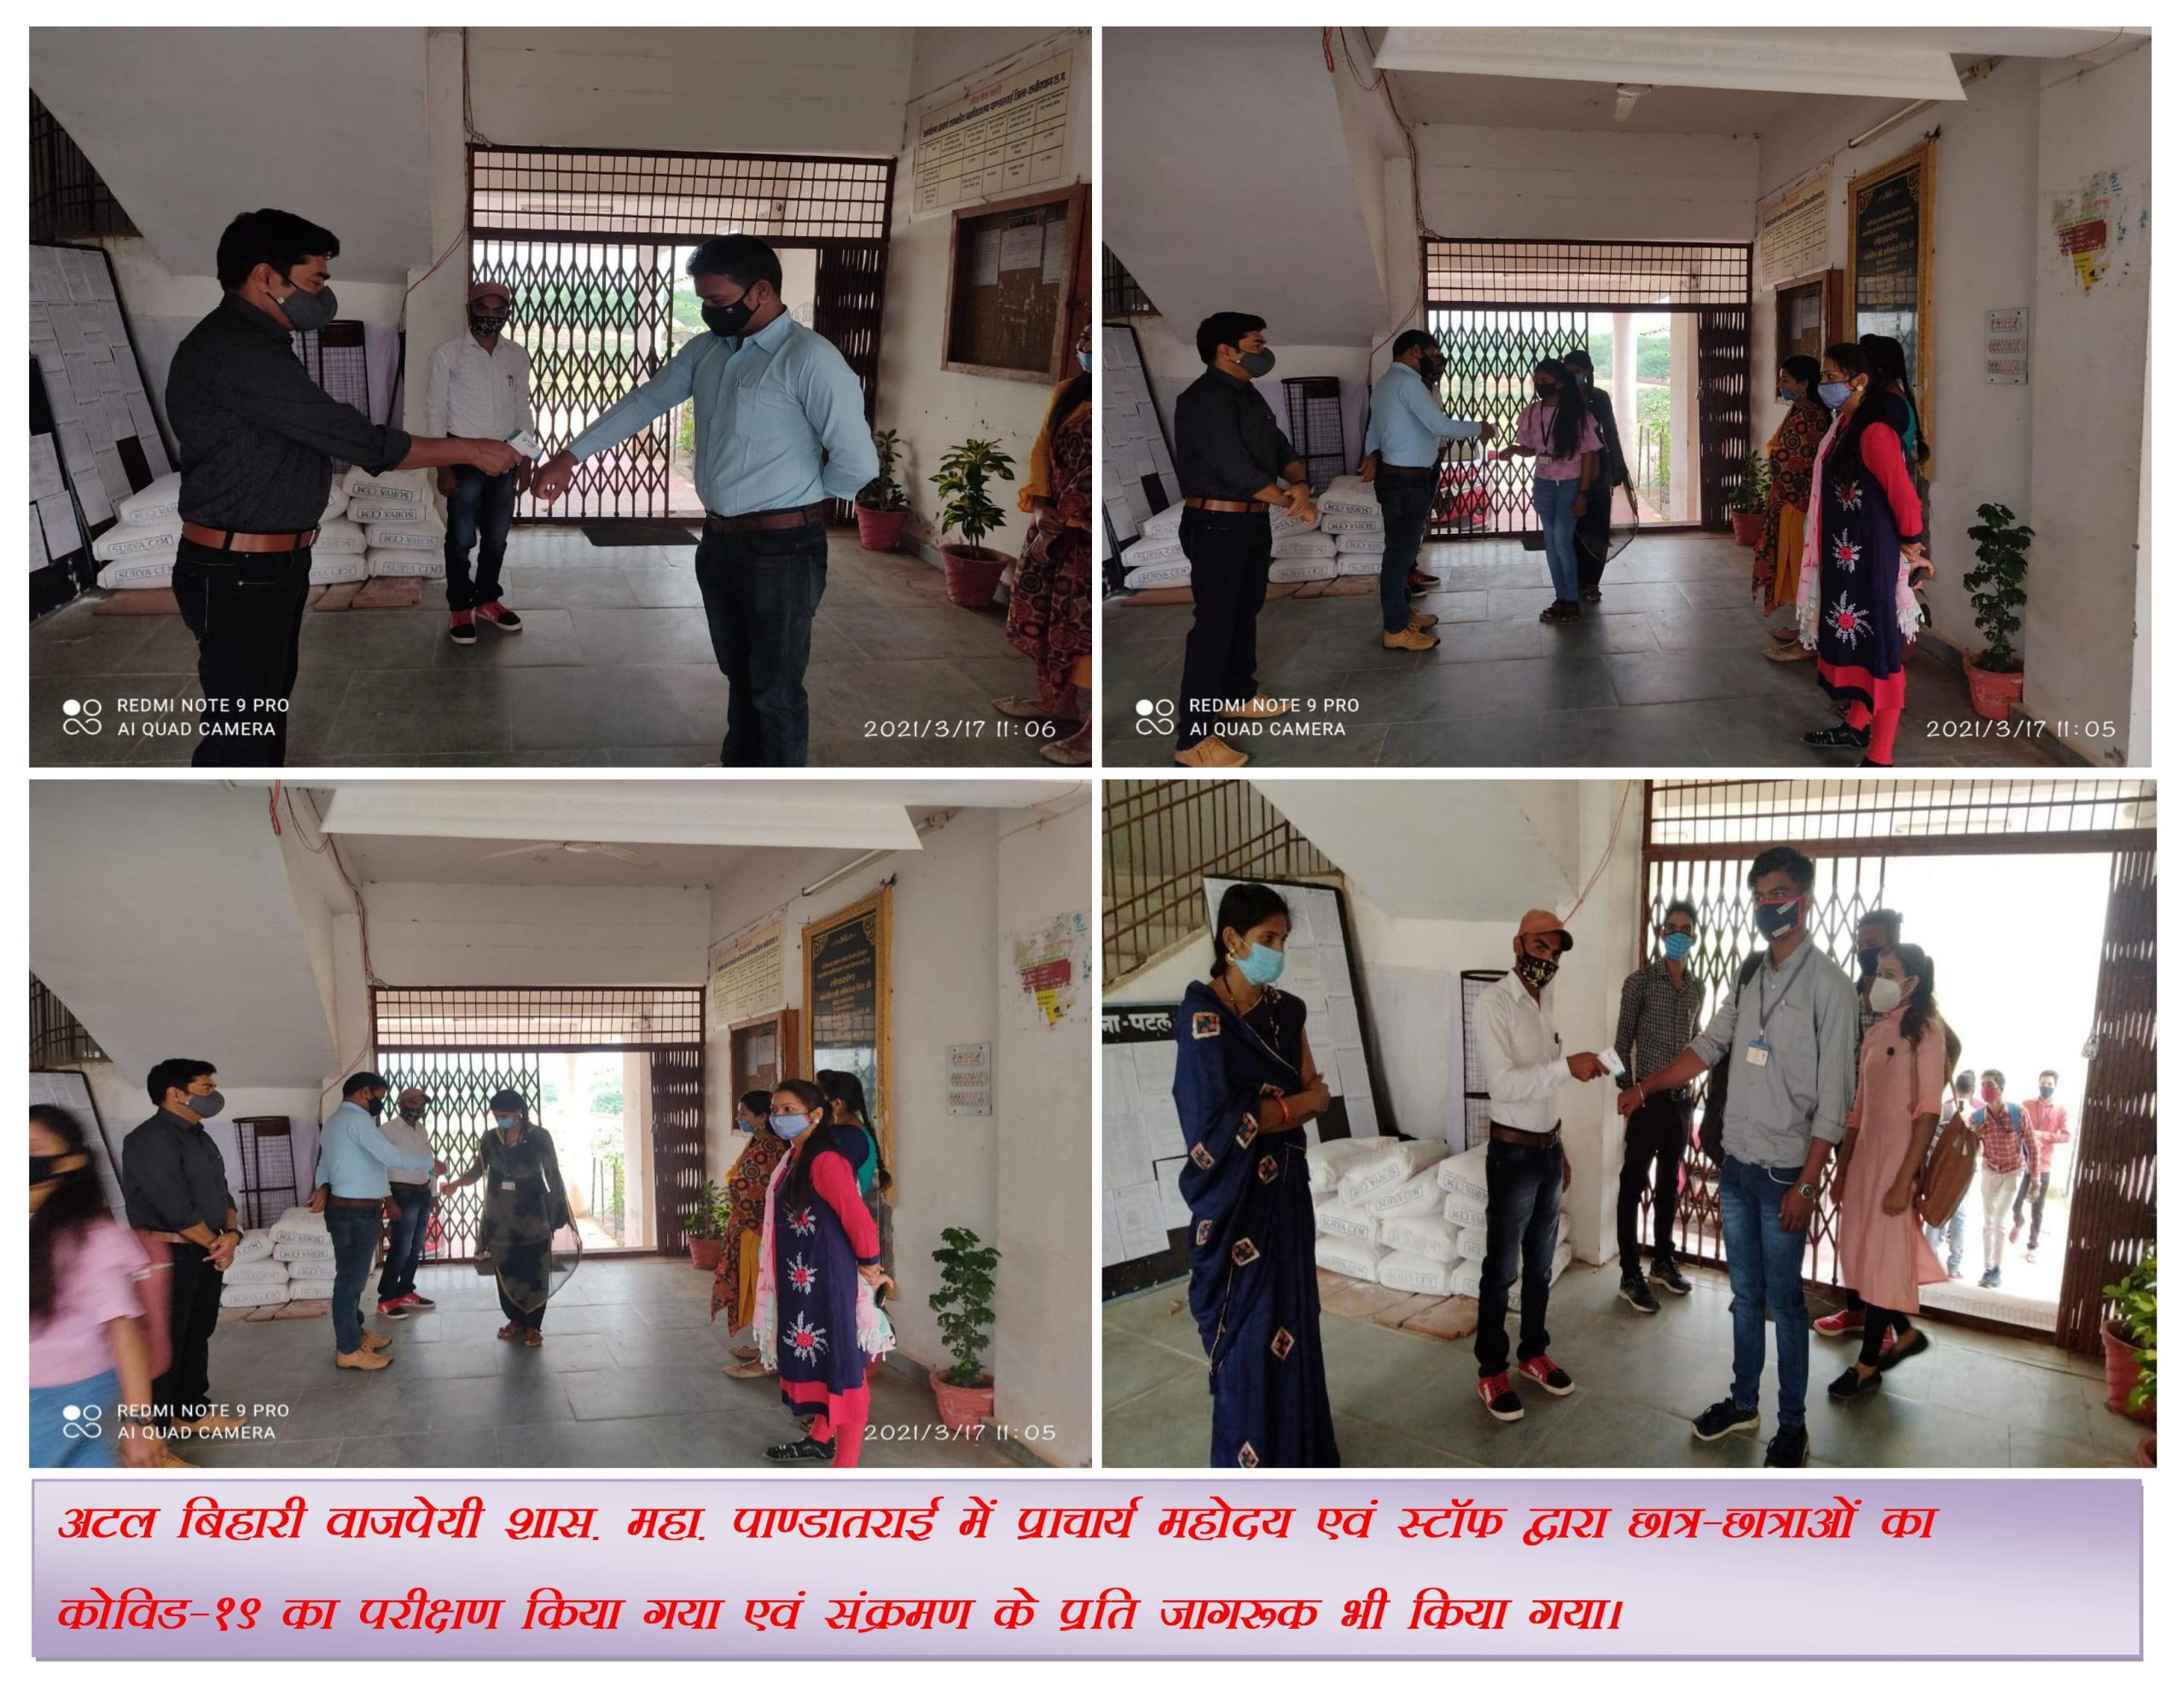
Atal Bihari Vajpayee Govt. College Pandatarai, Dist.-Kabirdham (C.G.)
Wb-https://abvgcp.ac.in
E-mail – pandataraigovtcollege3@gmail.com

Slide 26
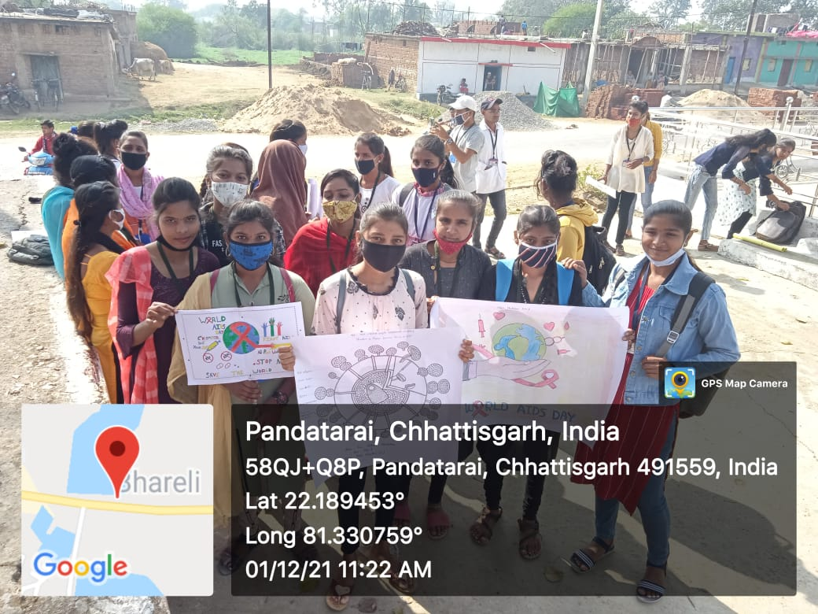
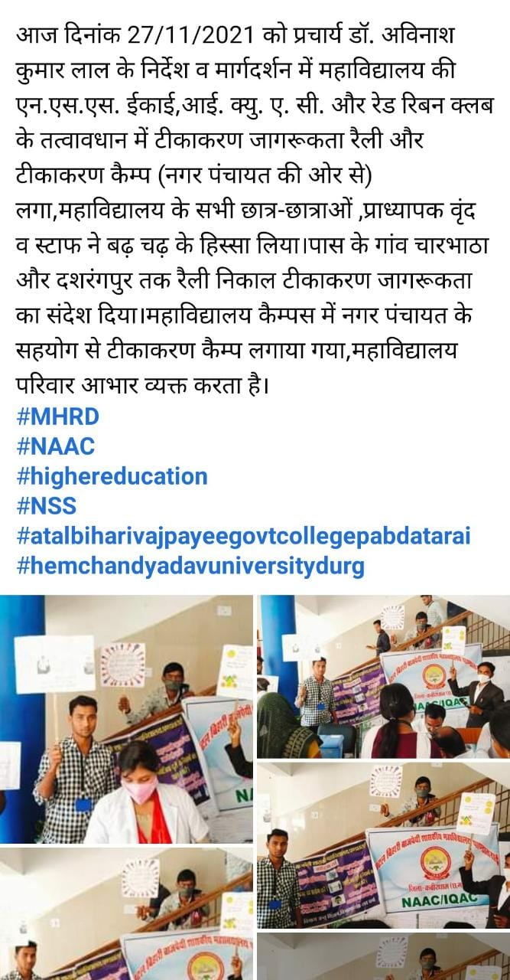
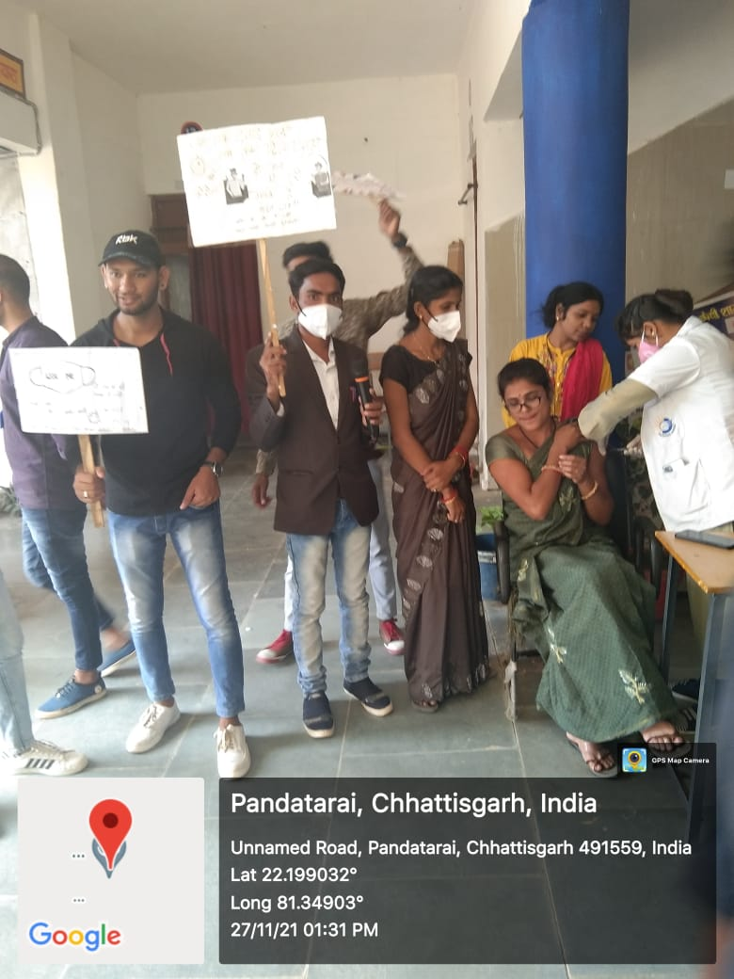
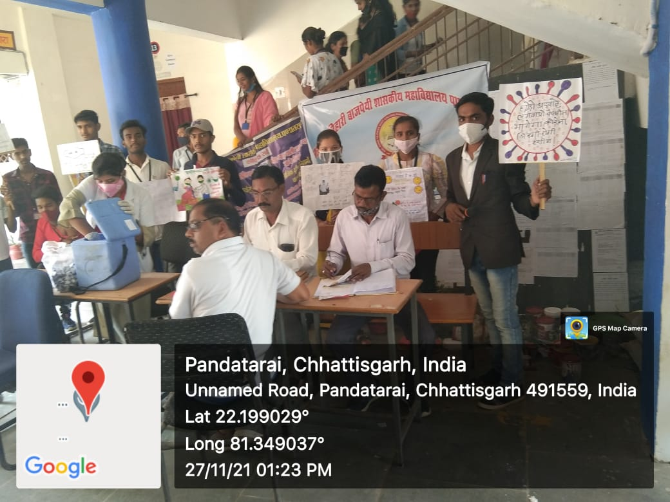
Atal Bihari Vajpayee Govt. College Pandatarai, Dist.-Kabirdham (C.G.)
Wb-https://abvgcp.ac.in
E-mail – pandataraigovtcollege3@gmail.com

Slide 27
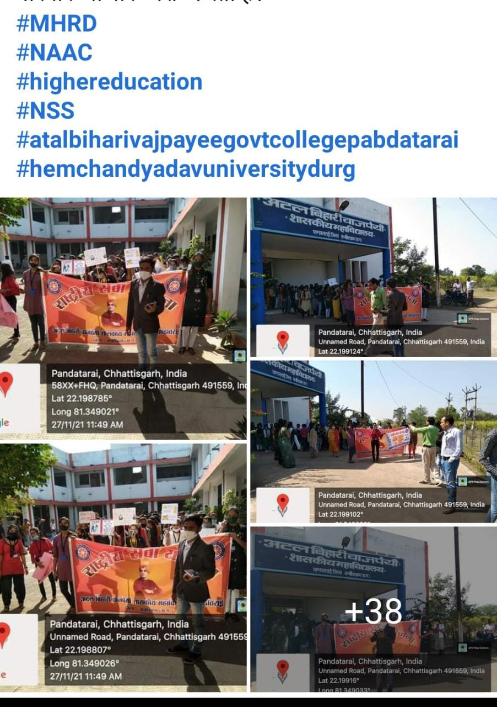
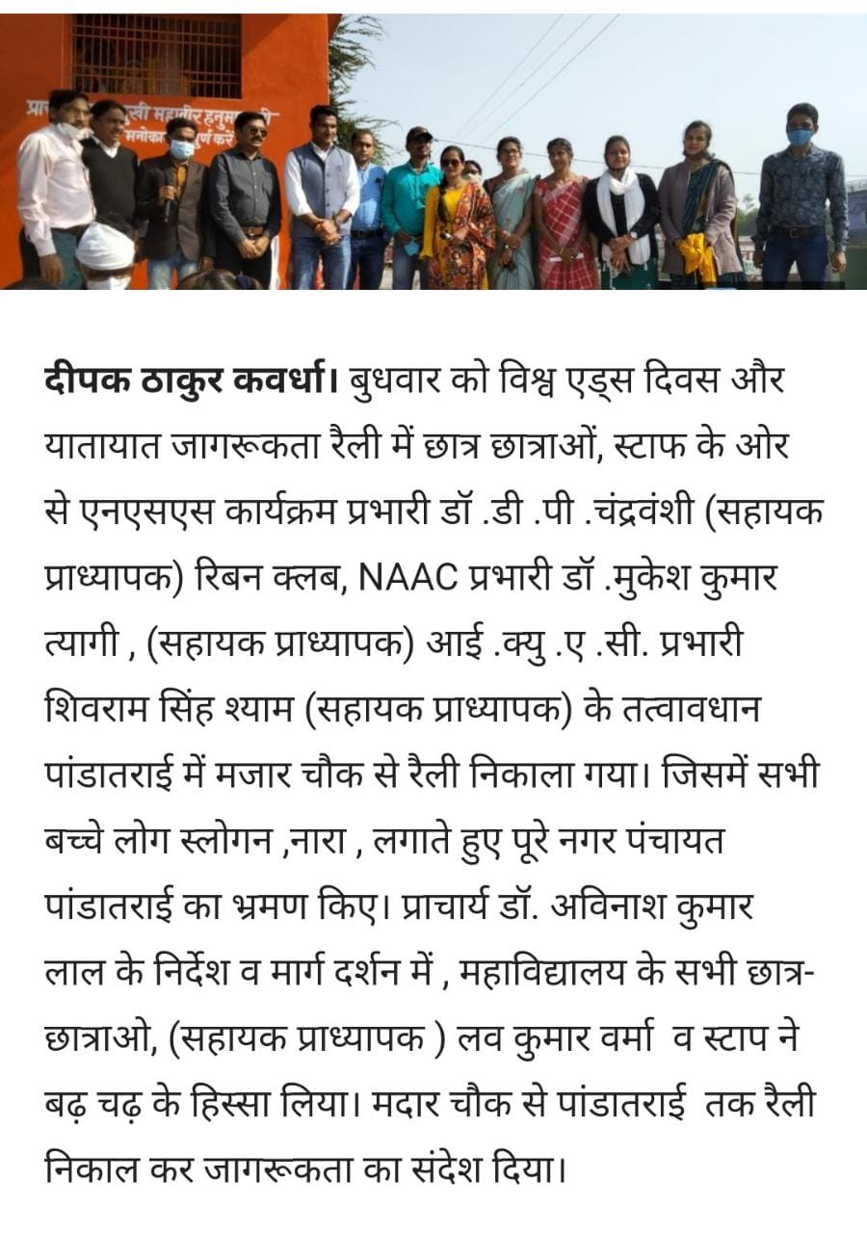
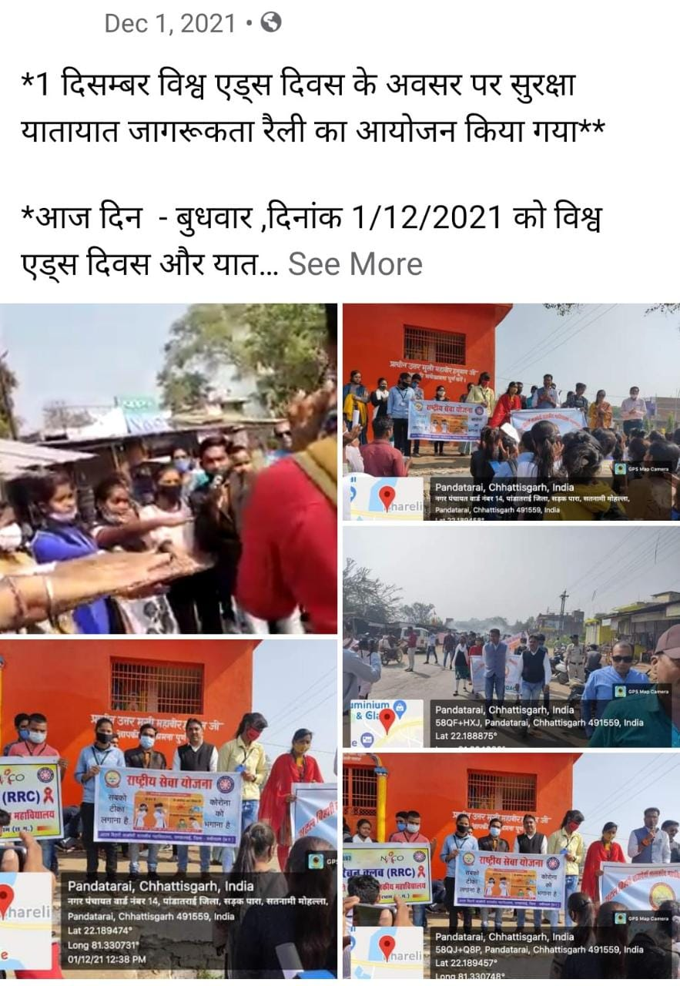
Atal Bihari Vajpayee Govt. College Pandatarai, Dist.-Kabirdham (C.G.)
Wb-https://abvgcp.ac.in
E-mail – pandataraigovtcollege3@gmail.com

Slide 28
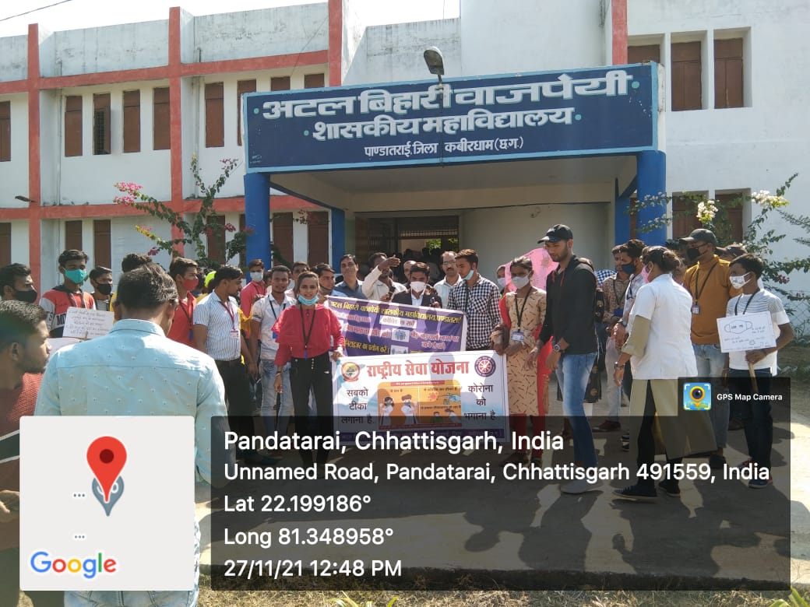
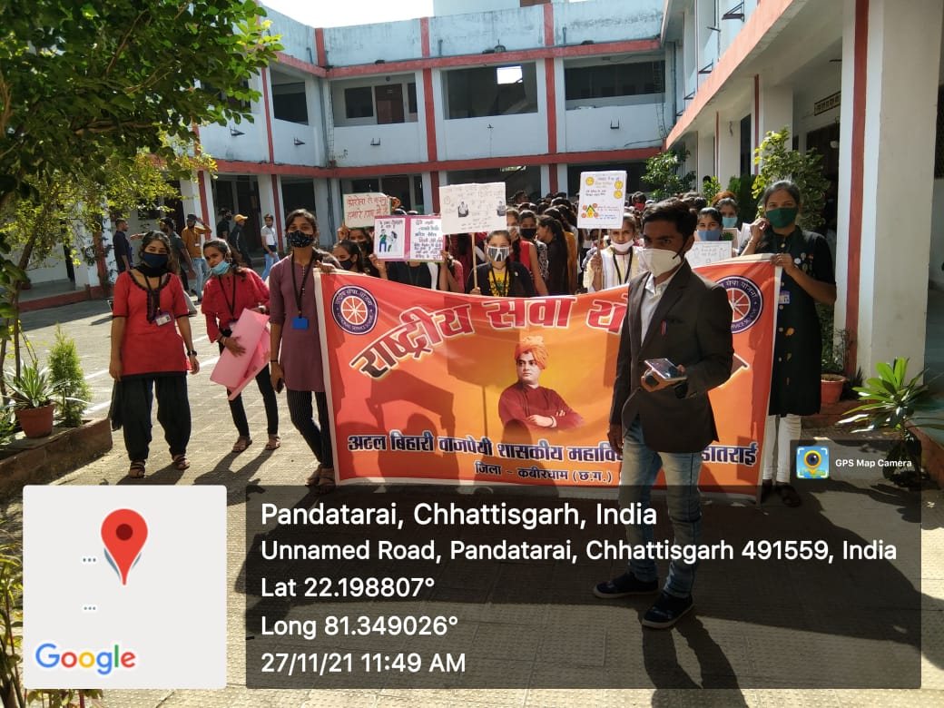
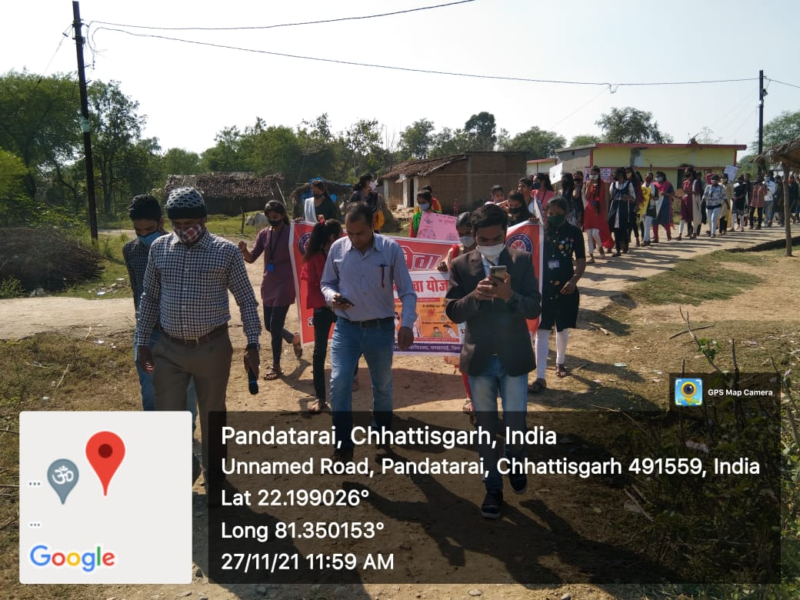
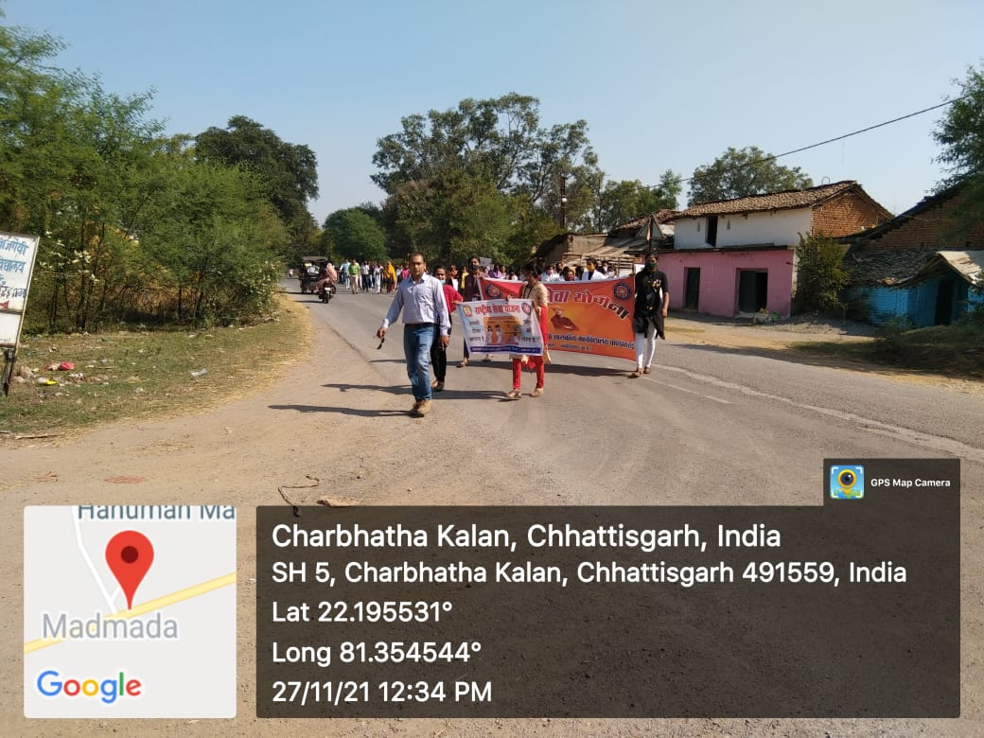
Atal Bihari Vajpayee Govt. College Pandatarai, Dist.-Kabirdham (C.G.)
Wb-https://abvgcp.ac.in
E-mail – pandataraigovtcollege3@gmail.com
कोविड19(कोरोना) के रोकथाम एंव नियंत्रण हेतु जागरूकता अभियान।

Slide 29
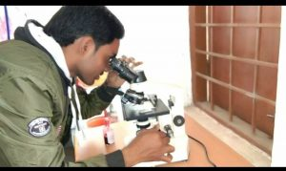
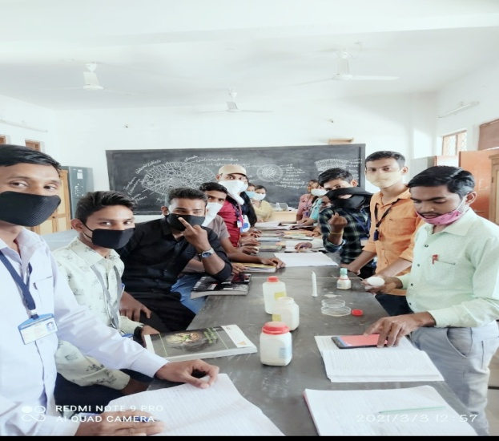
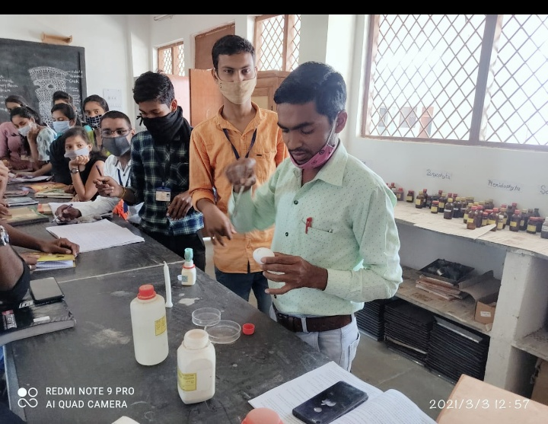
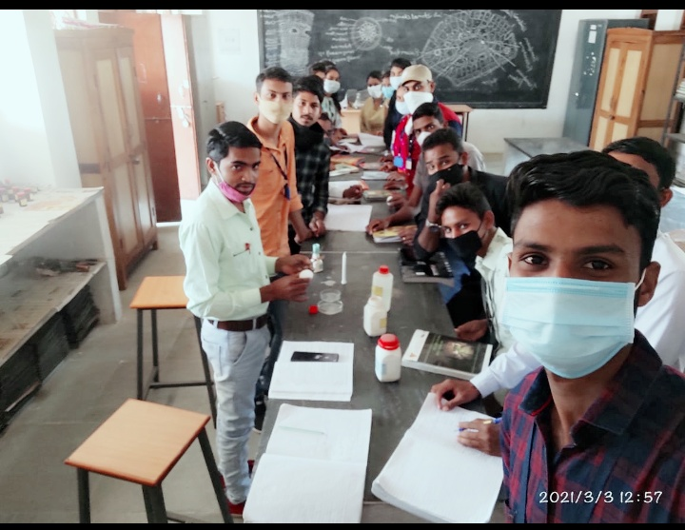
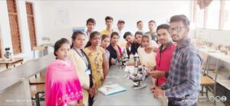
Atal Bihari Vajpayee Govt. College Pandatarai, Dist.-Kabirdham (C.G.)
Practical – Bio Chemical Test.
Wb-https://abvgcp.ac.in
E-mail – pandataraigovtcollege3@gmail.com
CLASS – B.SC. 3RD YEAR
Practical – Bio Chemical protein Test
Practical – Bio Chemical protein Test

Slide 30
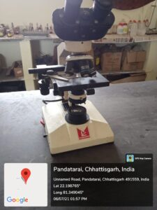
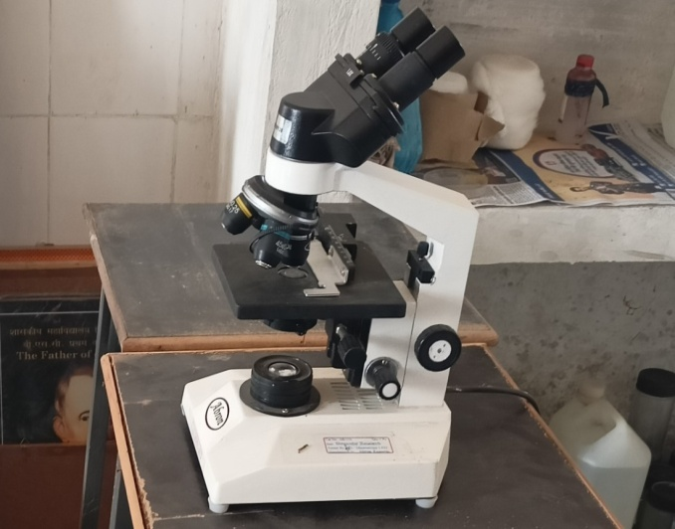
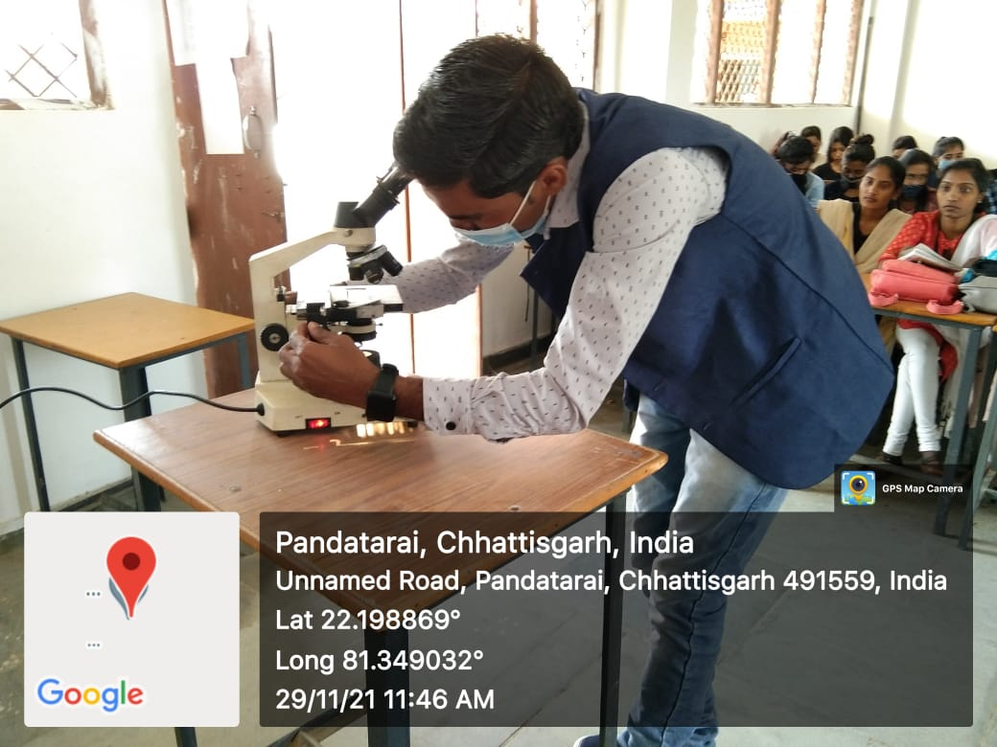
Atal Bihari Vajpayee Govt. College Pandatarai, Dist.-Kabirdham (C.G.)
Wb-https://abvgcp.ac.in
E-mail – pandataraigovtcollege3@gmail.com
CLASS – B.SC. 3RD YEAR BINOCULAR MICROSCOP
BINOCULAR MICROSCOP

Slide 31
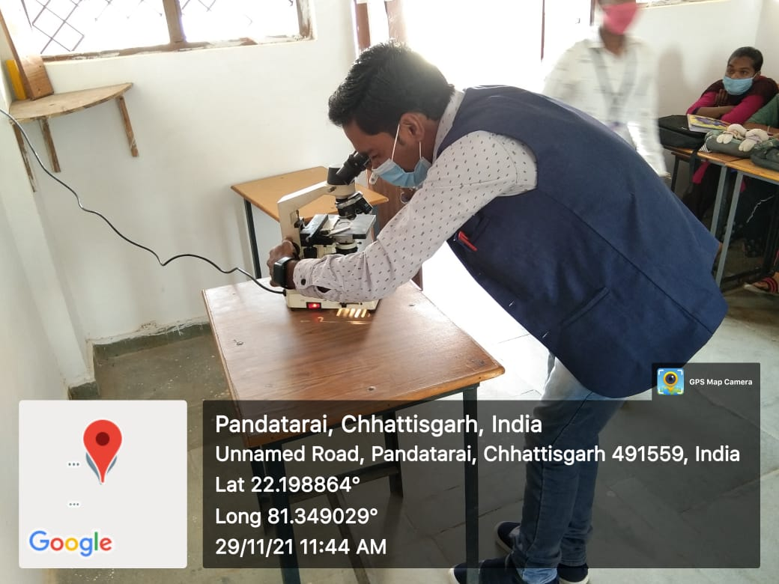
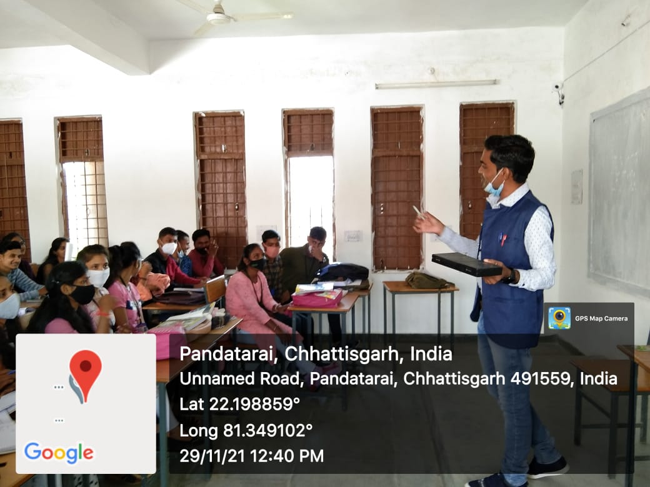
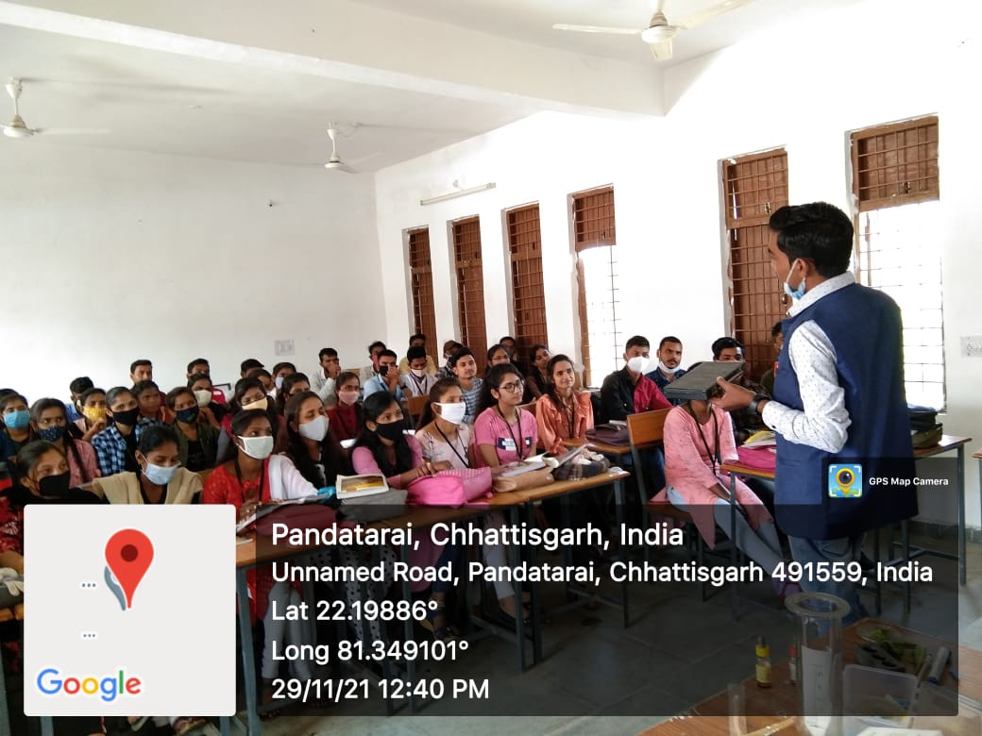
Atal Bihari Vajpayee Govt. College Pandatarai, Dist.-Kabirdham (C.G.)
Wb-https://abvgcp.ac.in
E-mail – pandataraigovtcollege3@gmail.com
CLASS – B.SC. 3RD YEAR BINOCULAR MICROSCOP
CLASS – B.SC. 3RD YEAR BINOCULAR MICROSCOP

Slide 32
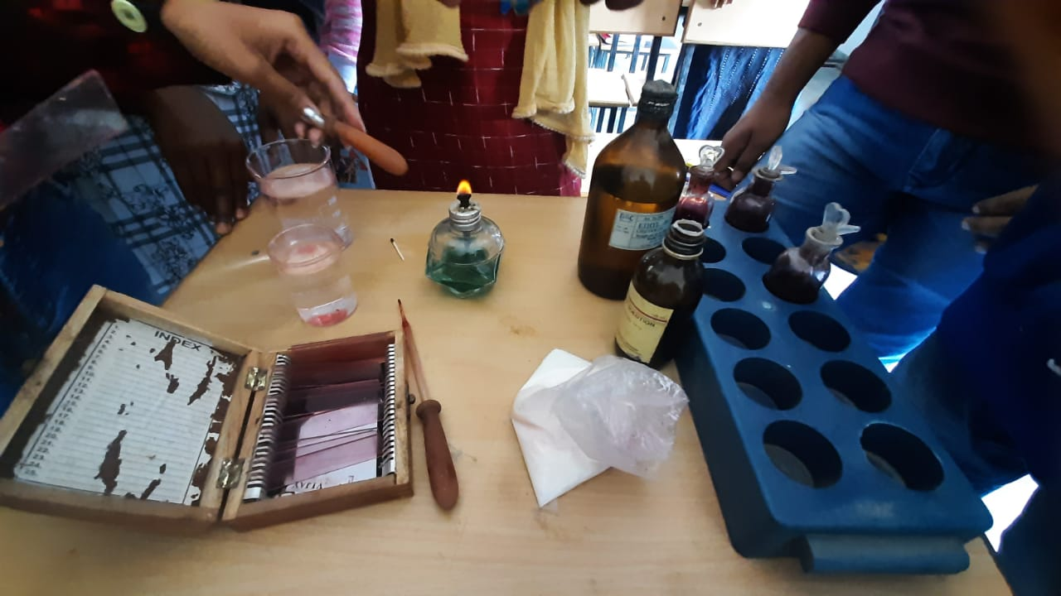
Atal Bihari Vajpayee Govt. College Pandatarai, Dist.-Kabirdham (C.G.)
Wb-https://abvgcp.ac.in
E-mail – pandataraigovtcollege3@gmail.com
GRAM POSITIVE AND
GRAM NEGETIVE TEST
CLASS – B.SC. 3RD YEAR

Slide 33
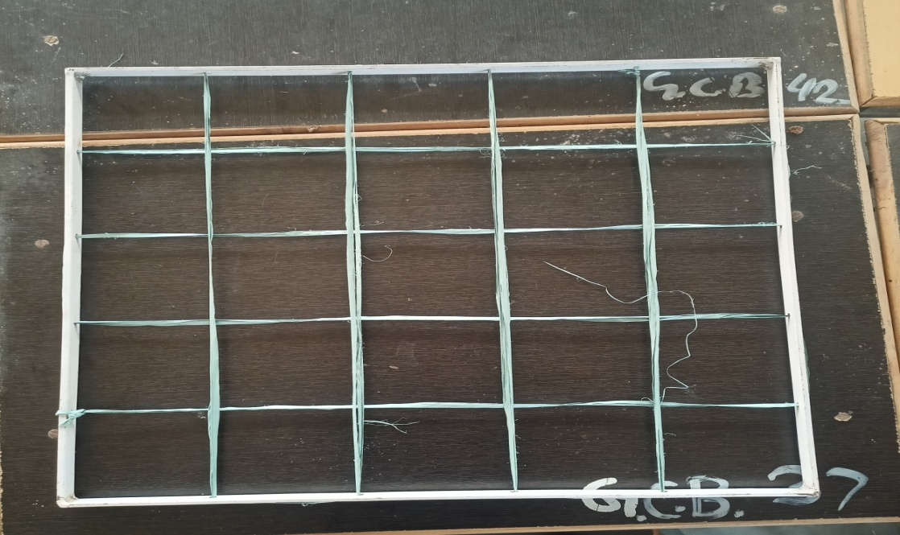
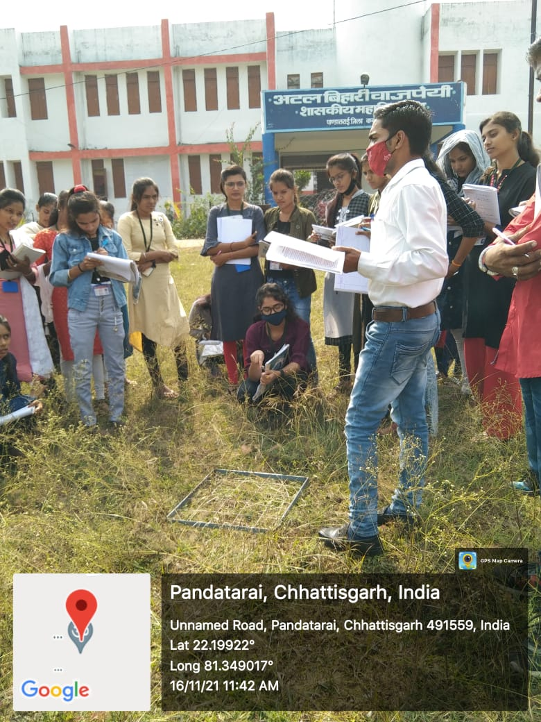
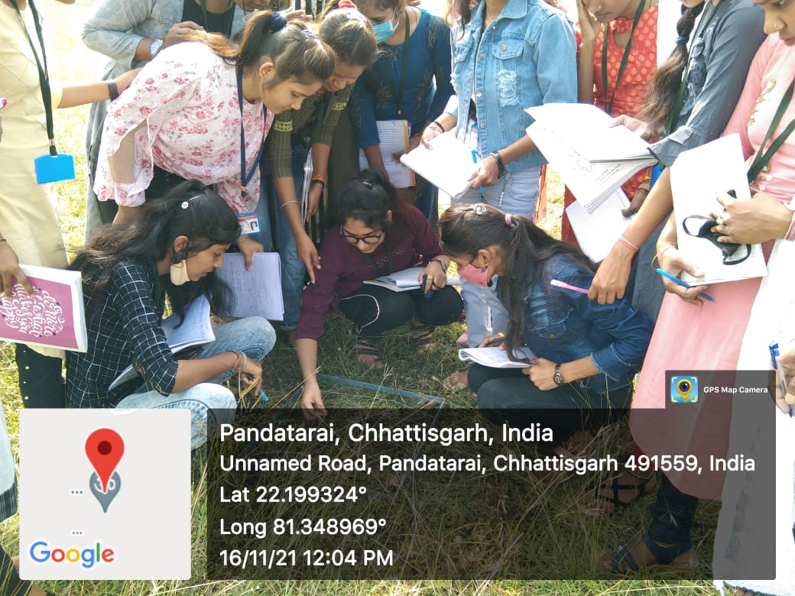
Atal Bihari Vajpayee Govt. College Pandatarai, Dist.-Kabirdham (C.G.)
Wb-https://abvgcp.ac.in
E-mail – pandataraigovtcollege3@gmail.com
DENCIYT BY QUADRATE BSC 3RD YEAR
QUADRATE
CLASS – B.SC. 3RD YEAR

Slide 34
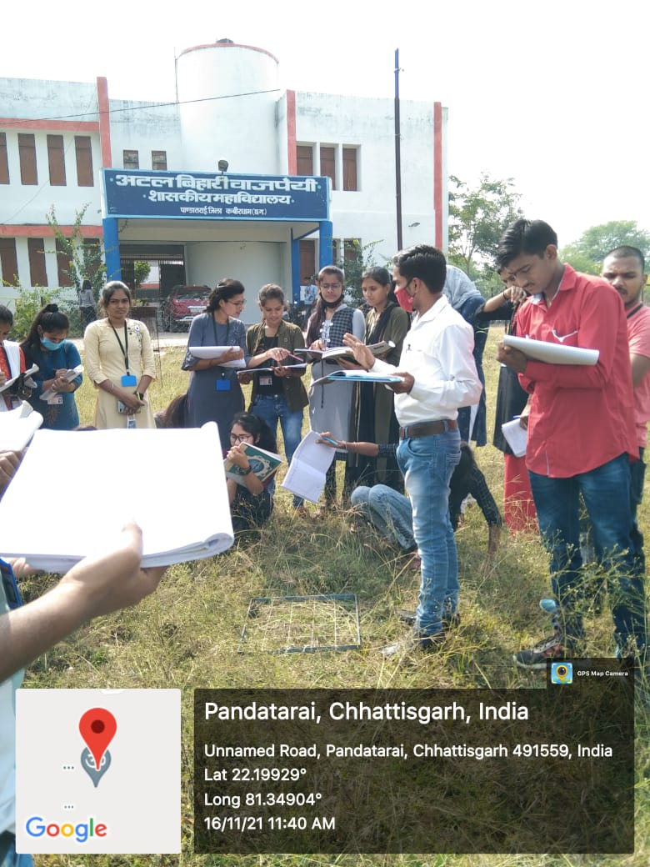
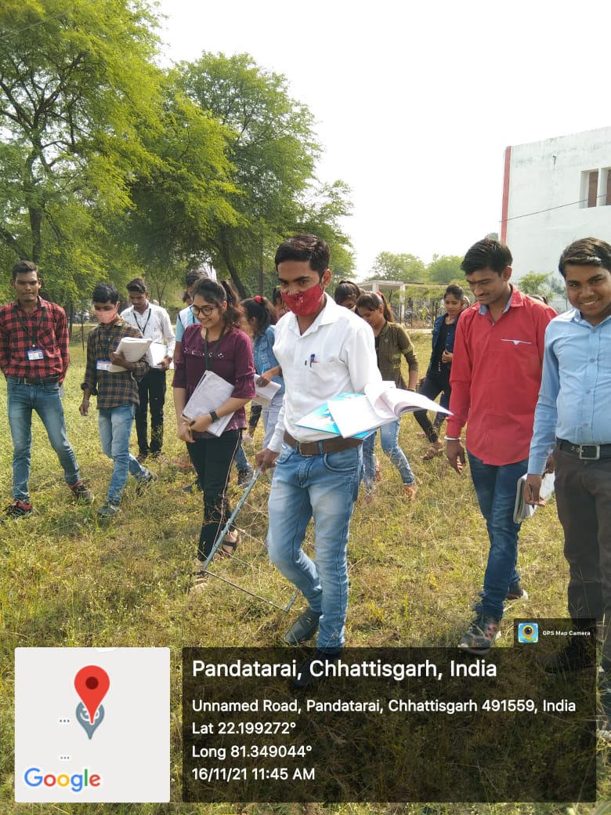
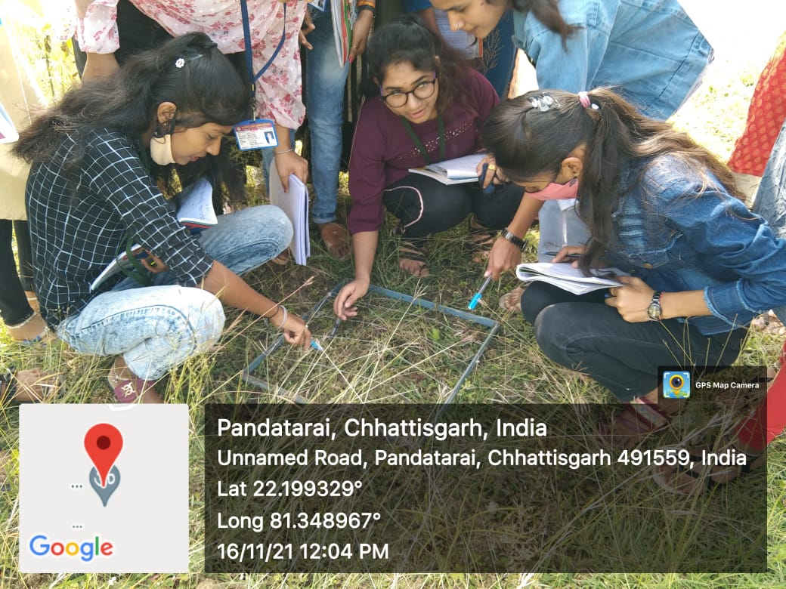
Atal Bihari Vajpayee Govt. College Pandatarai, Dist.-Kabirdham (C.G.)
Wb-https://abvgcp.ac.in
E-mail – pandataraigovtcollege3@gmail.com
DENCIYT BY QUADRATE BSC 3RD YEAR

Slide 35
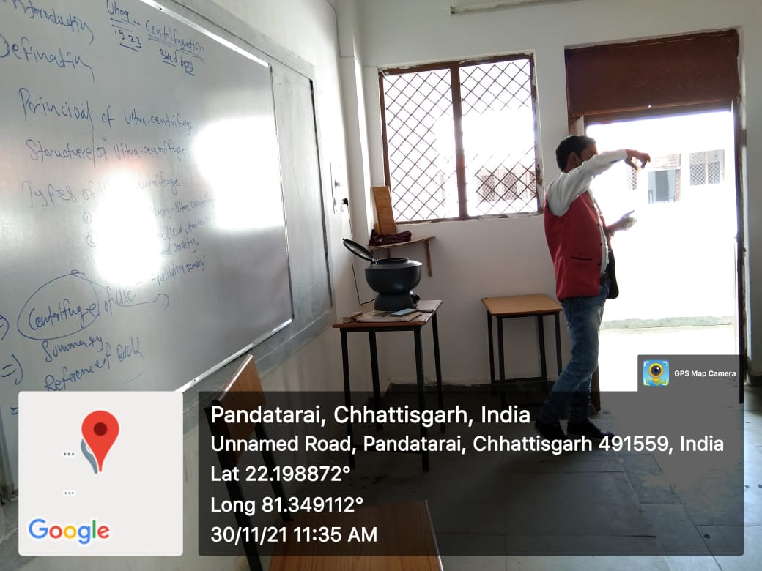
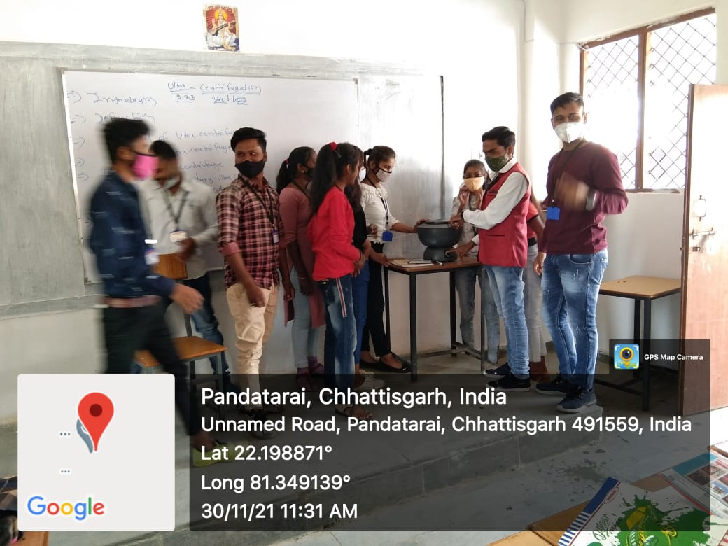
Atal Bihari Vajpayee Govt. College Pandatarai, Dist.-Kabirdham (C.G.)
Wb-https://abvgcp.ac.in
E-mail – pandataraigovtcollege3@gmail.com
Centrifuge BSC 3RD YEAR

Slide 36
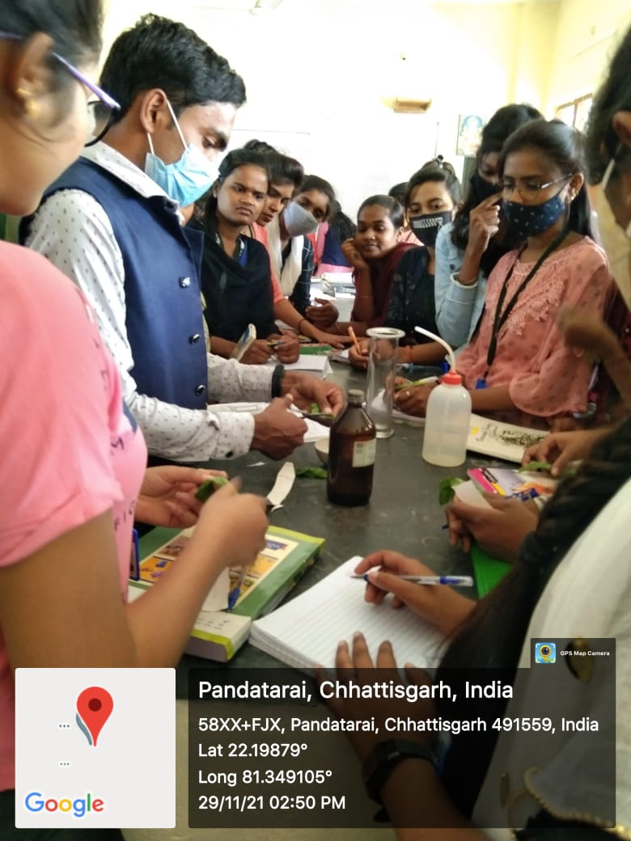
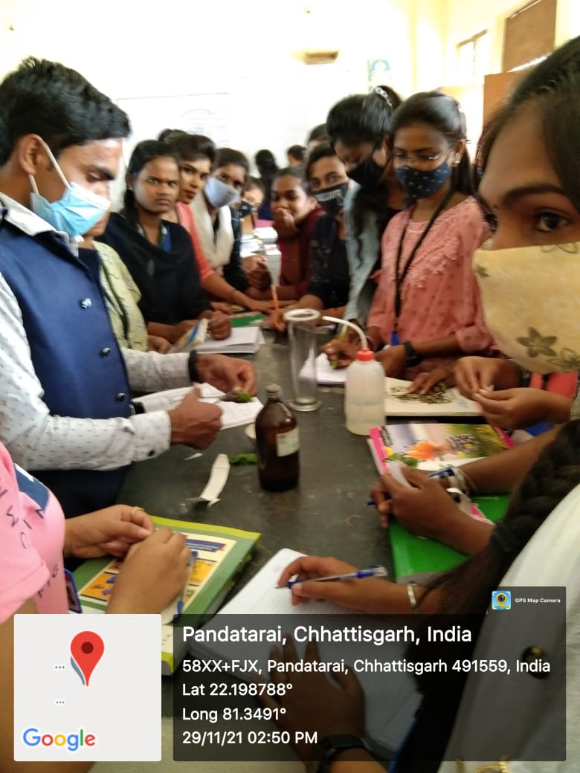


Atal Bihari Vajpayee Govt. College Pandatarai, Dist.-Kabirdham (C.G.)
Wb-https://abvgcp.ac.in
E-mail – pandataraigovtcollege3@gmail.com
Chromatography
BSC 3RD YEAR

Slide 37





Atal Bihari Vajpayee Govt. College Pandatarai, Dist.-Kabirdham (C.G.)
Wb-https://abvgcp.ac.in
E-mail – pandataraigovtcollege3@gmail.com
SLIDE

Slide 38




Atal Bihari Vajpayee Govt. College Pandatarai, Dist.-Kabirdham (C.G.)
Wb-https://abvgcp.ac.in
E-mail – pandataraigovtcollege3@gmail.com
BSC 2ND YEAR
RABBIT BONE
BSC 2ND YEAR

Slide 39



Atal Bihari Vajpayee Govt. College Pandatarai, Dist.-Kabirdham (C.G.)
Wb-https://abvgcp.ac.in
E-mail – pandataraigovtcollege3@gmail.com
DEESSECTING MICROSCOP
BINOCULAR MICROSCOPE
SIMPAL MICROSCOP

Slide 40



Atal Bihari Vajpayee Govt. College Pandatarai, Dist.-Kabirdham (C.G.)
Wb-https://abvgcp.ac.in
E-mail – pandataraigovtcollege3@gmail.com
बीएससी फर्स्ट ईयर Smart class online class.

Slide 41


Atal Bihari Vajpayee Govt. College Pandatarai, Dist.-Kabirdham (C.G.)
Wb-https://abvgcp.ac.in
E-mail – pandataraigovtcollege3@gmail.com
B.Sc. III YEAR ECOLOGY PRACTICAL
B.Sc. III YEAR ECOLOGY PRACTICAL
B.Sc. III YEAR ECOLOGY PRACTICAL

Slide 42




Atal Bihari Vajpayee Govt. College Pandatarai, Dist.-Kabirdham (C.G.)
Wb-https://abvgcp.ac.in
E-mail – pandataraigovtcollege3@gmail.com
बीएससी फर्स्ट ईयर
बीएससी फर्स्ट ईयर

Slide 43


Atal Bihari Vajpayee Govt. College Pandatarai, Dist.-Kabirdham (C.G.)
Wb-https://abvgcp.ac.in
E-mail – pandataraigovtcollege3@gmail.com
MITOSIS DIVISION-ONIAN ROOTS Tips CLASS – B.SC. 3RD YEAR

Slide 44



Atal Bihari Vajpayee Govt. College Pandatarai, Dist.-Kabirdham (C.G.)
Wb-https://abvgcp.ac.in
E-mail – pandataraigovtcollege3@gmail.com
HAEMOMETER

Slide 45


Atal Bihari Vajpayee Govt. College Pandatarai, Dist.-Kabirdham (C.G.)
Wb-https://abvgcp.ac.in
E-mail – pandataraigovtcollege3@gmail.com

Slide 46



Atal Bihari Vajpayee Govt. College Pandatarai, Dist.-Kabirdham (C.G.)
Wb-https://abvgcp.ac.in
E-mail – pandataraigovtcollege3@gmail.com
B.Sc.III YEAR SMART CLASS
ICT CLASSROOM

Slide 47






Atal Bihari Vajpayee Govt. College Pandatarai, Dist.-Kabirdham (C.G.)
Wb-https://abvgcp.ac.in
E-mail – pandataraigovtcollege3@gmail.com

Slide 48

Atal Bihari Vajpayee Govt. College Pandatarai, Dist.-Kabirdham (C.G.)
Wb-https://abvgcp.ac.in
E-mail – pandataraigovtcollege3@gmail.com

Slide 49

Atal Bihari Vajpayee Govt. College Pandatarai, Dist.-Kabirdham (C.G.)
Wb-https://abvgcp.ac.in
E-mail – pandataraigovtcollege3@gmail.com

Slide 50




Atal Bihari Vajpayee Govt. College pandatarai Dist.-Kabirdham (C.G.)
wb-abvgcp.ac.in Email-pandataraigovtcollege3@gmail.com
Affiliated to Hemchand Yadav University Durg (C.G.)
Science Festival 28 February 2022
Science Model/Poster Comtetion, Best from the Waste, Quiz Competition, Scientific Rangoli
Chairperson
Dr. Avinash Kumar Lall
Principal
Atal Bihari Vajpayee Govt. College Pandatarai, Dist.-Kabirdham (C.G.)
Convener
Dr. M.K.Tyagi
Assts. Prof. Chemistry
Atal Bihari Vajpayee Govt. College Pandatarai, Dist.-Kabirdham (C.G.)
Chief-Guest
Dr. Dakeshwar Kumar Verma
Assts. Prof. Chemistry
GOVT. DIGVIJAY AUTONOMOUS POSTGRADUATE COLLEGE
RAJNANDGAON (C.G.)
Co- Convener
Kamini Verma
Lecturer Botany
Atal Bihari Vajpayee Govt. College Pandatarai, Dist.-Kabirdham (C.G.)
Co- Convener
Ku. Tinkeshwari Keshari
Lecturer Chemistry
Atal Bihari Vajpayee Govt. College Pandatarai, Dist.-Kabirdham (C.G.)
Co- Convener
Lav Kumar Verma
Lecturer Zoology
Atal Bihari Vajpayee Govt. College Pandatarai, Dist.-Kabirdham (C.G.)
Registration Contact No. -
1- Tinkeshwari Keshari - 6261382577
2- Kamini Verma – 8109139184
3- Lav Kumar Verma - 8358869412

Slide 51


Atal Bihari Vajpayee Govt. College Pandatarai, Dist.-Kabirdham (C.G.)
Wb-https://abvgcp.ac.in
E-mail – pandataraigovtcollege3@gmail.com

Slide 52



Atal Bihari Vajpayee Govt. College Pandatarai, Dist.-Kabirdham (C.G.)
Wb-https://abvgcp.ac.in
E-mail – pandataraigovtcollege3@gmail.com

Slide 53

Atal Bihari Vajpayee Govt. College Pandatarai, Dist.-Kabirdham (C.G.)
Wb-https://abvgcp.ac.in
E-mail – pandataraigovtcollege3@gmail.com

Slide 54




Atal Bihari Vajpayee Govt. College Pandatarai, Dist.-Kabirdham (C.G.)
Wb-https://abvgcp.ac.in
E-mail – pandataraigovtcollege3@gmail.com
LECTURE BY GUEST
TOPIC- CAREER COUNCLING FOR ZOOLOGY STUDENTS

Slide 55
Atal Bihari Vajpayee Govt. College Pandatarai, Dist.-Kabirdham (C.G.)
Wb-https://abvgcp.ac.in
E-mail – pandataraigovtcollege3@gmail.com
Thank you

